Slide 1
Application Gateway (Proxy)

Slide 2
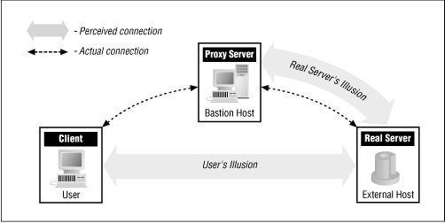
Basic Concept
The user's client program talks to a proxy server instead of directly to the "real" server out on the Internet. The proxy server evaluates requests from the client and decides which to pass on and which to disregard.
If a request is approved, the proxy server talks to the real server on behalf of the client (thus the term "proxy"), and proceeds to relay requests from the client to the real server, and to relay the real server's answers back to the client.

Slide 3
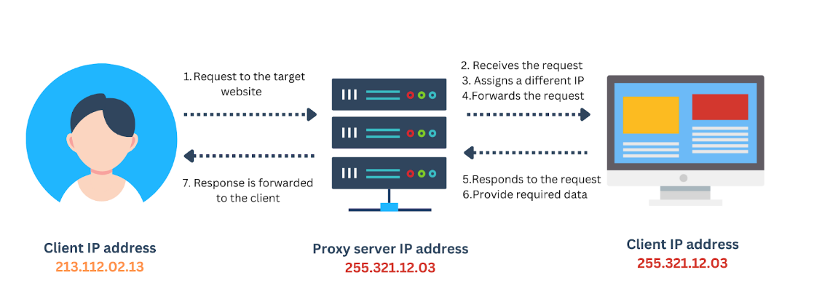
Example

Slide 4
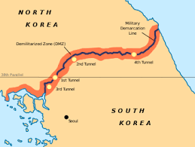
De-Militarized Zone (DMZ)

Slide 5
DMZ Basics
De-Militarized Zone (DMZ) is a buffer zone between a completely untrusted network (like the Internet) and a relatively trusted network (like your private LAN).
The primary reason for implementing a DMZ is to keep your public and private assets separated so that a compromise in the public area does not automatically result in a compromise of your private assets as well.

Slide 6
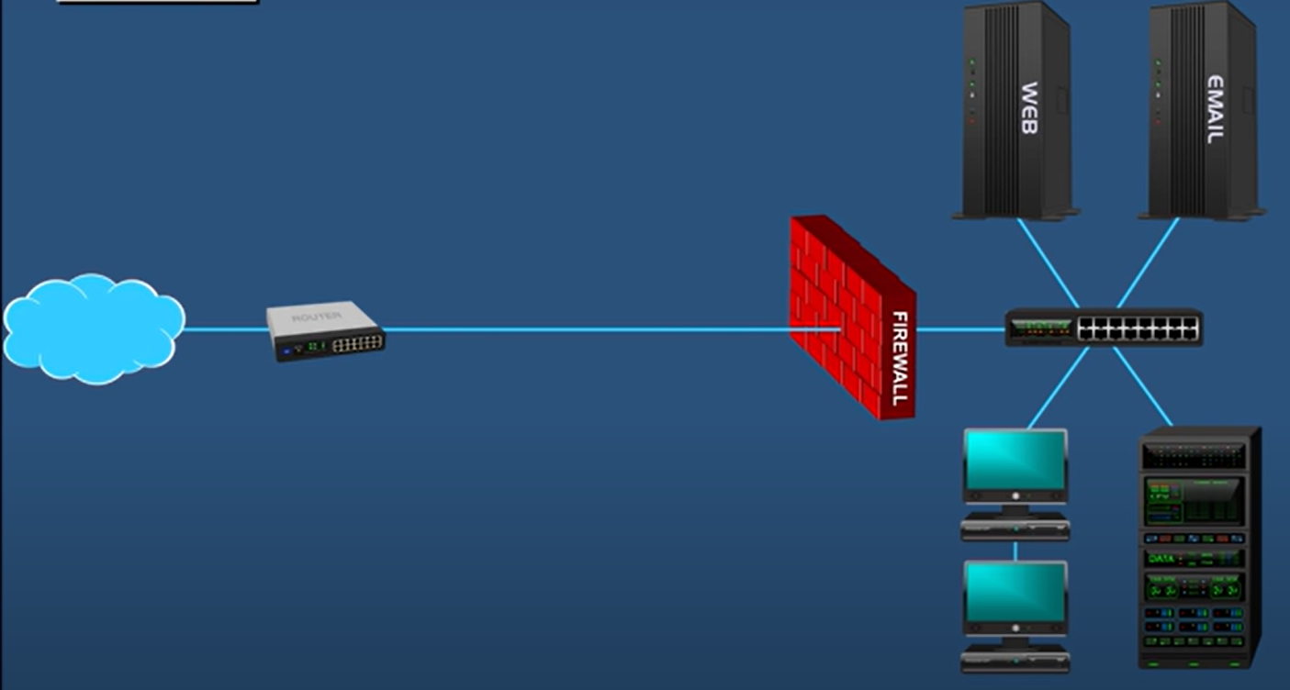
Using a Single Firewall
A company has its web and email server behind a firewall
Outside users must come through this firewall – Is it ok?
Your public servers
Your private network (LAN)

Slide 7
Using a Single Firewall
The problem is, in spite of the firewall if the web/email server is hacked, the external user will be able to get inside the other hosts/servers inside the LAN

Slide 8
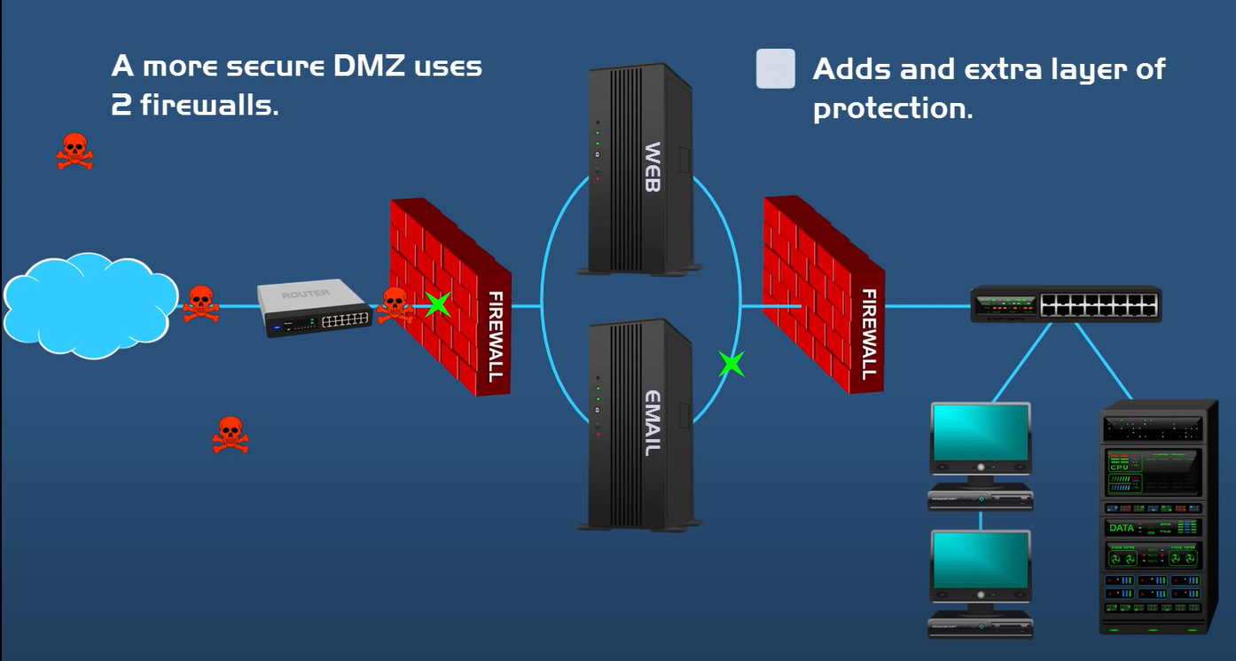
Solution? DMZ
Your public servers
Your private network (LAN)

Slide 9
Why a DMZ?
Let’s say you are running a web server, an FTP server, and a game server.
On your border router/firewall you allow ports 80, 21, and 5347 (the game server port).
All other attempted connections to your external IP address are denied access.
Now what happens if someone finds and attacks a vulnerability in one of these servers?
Your second and more powerful firewall does not pass any traffic from the DMZ inside to the LAN, thus protecting it.
The only traffic that is going to make it through that firewall is traffic that you specifically request be allowed (Example: An internal user had opened a TCP connection to an outside server, which has responded.)
But do not allow brand new connections from outside.

Slide 10
DMZ Advantages
Access control – An increased degree of protection guarantees that only genuine traffic can enter the DMZ, making it extremely difficult for hackers to penetrate internal networks since they would have to pass through two firewalls to get access.
Prevents network reconnaissance – It acts as an intermediary, preventing attackers from conducting reconnaissance activity to hunt for potential targets. If a DMZ system is hacked, the internal firewall protects the private network and makes external surveillance difficult.
Protects from internet protocol (IP) spoofing: Attackers may try to gain access to systems by counterfeiting an IP address. A DMZ may recognize the IP address’s validity.

Slide 11
Screened Host Firewall

Slide 12
Bastion Host Concept
A bastion host is a special-purpose computer on a network specifically designed and configured to withstand attacks.
It is a server whose purpose is to provide access to a private network from an external network, such as the Internet. Because of its exposure to potential attack, a bastion host must minimize the chances of penetration.
Example follows …

Slide 13
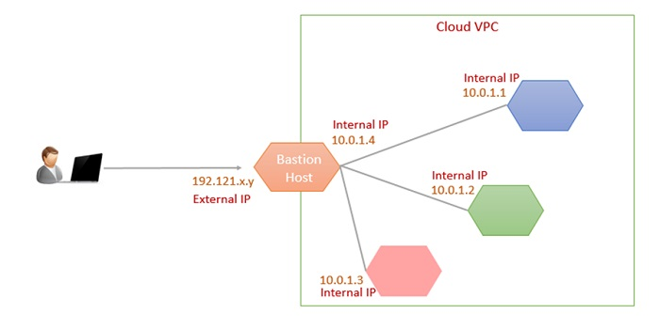
Bastion Host Example

Slide 14
Bastion Host Example
All isolated instances have only internal IP addresses in the VPC.
However, the Bastion host instance has an external IP address as well as an internal IP address.
If we need to access instances on the internal network that do not have an external IP address, we can connect to the Bastion host and then connect to our internal instances from that Bastion host.
This method uses a two-step SSH connection.
Since the Bastion host uses a two-step SSH connection, it allows us to connect to the development environment without external IPs and additional firewall rules.
When using a bastion host, we log into the bastion host first, and then into our target private instance.
Because of this two-step login, the bastion hosts are sometimes called "jump servers."
The Bastion host can be started and stopped to enable or disable inbound SSH communication from the Internet.

Slide 15
Screened Host Firewall
There are two types of screened host firewalls
Single homed bastion host
Dual homed bastion host
Single homed bastion host: This has a (a) packet filtering router and (b) a bastion host.
Dual homed bastion host: Here, a bastion host has two network cards: one is used for internal connection and the second one is used for connection with the router.

Slide 16
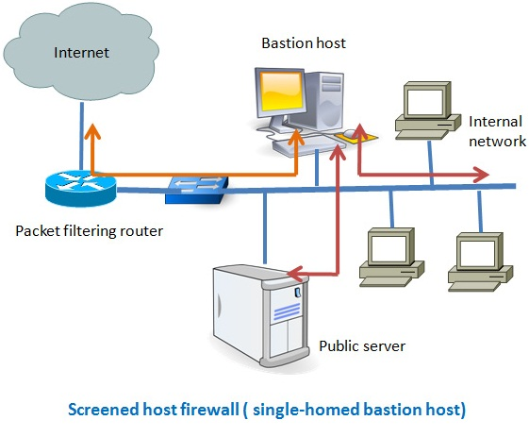
Screened Host Firewall - Single Homed Bastion Host
This has a (a) packet filtering router and (b) a bastion host.
Traffic from the Internet can only reach the bastion host; it cannot reach the internal network.
Outgoing traffic having the IP address of the bastion host can only go to the Internet.
No traffic from the internal network can go to the Internet.

Slide 17
Screened Host Firewall - Single Homed Bastion Host
This type of configuration can have a web server placed in between the router and the bastion host in order to allow the public to access the server from the Internet.
The main problem with the single homed bastion host is that if the packet filter router gets compromised then the entire network will be compromised.

Slide 18
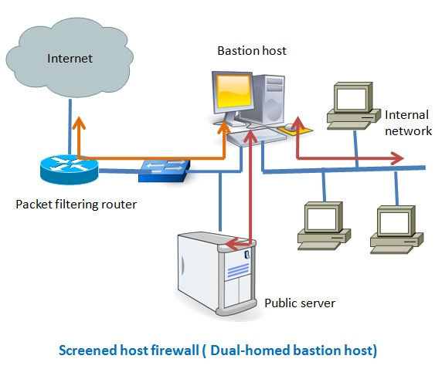
Screened Host Firewall - Dual Homed Bastion Host
In the dual homed bastion host firewall system, the bastion host has two network cards: one is used for internal connection and the other is used for connection with the router.
In this case, even if, the router got compromised, the internal network will remain unaffected since it is in a separate network zone.

Slide 19
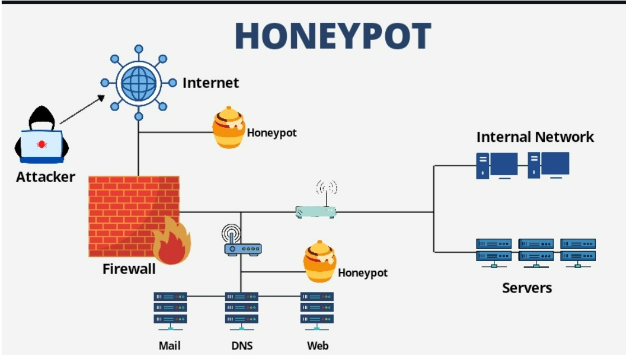
Honeypot

Slide 20
NextGen Firewall

Slide 21
NextGen Firewall
A Next-Generation firewall (NGFW) is a firewall designed to protect against the modern cyber threats that companies face.
An NGFW operates at the application layer of the TCP/IP stack to apply intrusion prevention system (IPS), anti-malware, sandboxing and other protections.
These functions allow an NGFW to identify and block advanced threats.

Slide 22
Hands-on with CISCO ASA
https://www.youtube.com/watch?v=jOYvI6aBVE8

Slide 23
Cisco ASA
Adaptive Security Appliance (ASA) is a security device that combines firewall, antivirus, intrusion prevention, and VPN capabilities
Now all Cisco firewall products are sold under the brand Cisco Firepower, because Cisco had acquired a security product company called Sourcefire in 2013
Our example: C:\lectures\CDAC\DITISS\NDC\Cisco ASA Example.pkt

Slide 24
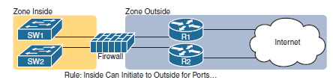
Zone Concept

Slide 25
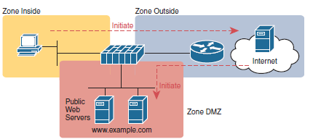
Zones and DMZ

Slide 26
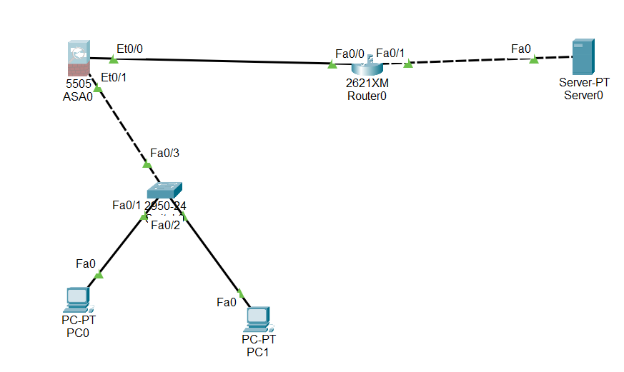
Create the following Topology

Slide 27
Basic steps in asa firewall
ciscoasa>en
Password:
ciscoasa#config t
ciscoasa(config)#
ciscoasa(config)#show running-config
It shows that some interfaces have been configured by default and there is a DHCP server also configured. Copy its address, so that we can remove the DHCP configuration.

Slide 28
Basic steps in asa firewall
ciscoasa#config t
ciscoasa(config)#no dhcpd address 192.168.1.5-192.168.1.36 inside
Remove the default DHCP configuration.

Slide 29
Create VLAN 1 and make interface e0/1 a part of it
ciscoasa(config)#int vlan 1
ciscoasa(config-if)#ip add 10.1.1.1 255.0.0.0
ciscoasa(config-if)#nameif inside
ciscoasa(config-if)#security-level 100
ciscoasa(config-if)#exit
ciscoasa(config)#int e0/1
ciscoasa(config-if)#switchport access vlan 1
100 = Trust level is the highest for LAN

Slide 30
Create VLAN 2 and make interface e0/0 a part of it
ciscoasa(config)#int vlan 2
ciscoasa(config-if)#ip add 50.1.1.2 255.0.0.0
ciscoasa(config-if)#no shutdown
ciscoasa(config-if)#nameif outside
ciscoasa(config-if)#security-level 0
Make the interface E0/0 a part of Vlan 2
ciscoasa(config-if)#exit
ciscoasa(config)#int e0/0
ciscoasa(config-if)#switchport access vlan 2
0 = Trust level is the lowest for the intenet

Slide 31
Router Configuration now …
Router>en
Router#config t
Router(config)#int f0/0
Router(config-if)#ip add 50.1.1.1 255.0.0.0
Router(config-if)#no shutdown
Router(config-if)#int f0/1
Router(config-if)#ip add 8.8.8.1 255.0.0.0
Router(config-if)#no shut

Slide 32
Now the Server …
Open server, Desktop-IP configuration
IP address: 8.8.8.8
Subnet mask: 255.0.0.0
Default gateway: 8.8.8.1

Slide 33
PC Configurations
PC0: IP 10.1.1.2, Default gateway: 10.1.1.1, DNS: 8.8.8.8
PC1: IP 10.1.1.3, Default gateway: 10.1.1.1, DNS: 8.8.8.8

Slide 34
Back to asa … Default Route for Outgoing Packets
ciscoasa(config)#route outside 0.0.0.0 0.0.0.0 50.1.1.1

Slide 35
Configure OSPF on the Router
Router(config)#router ospf 1
Router(config-router)#net 50.0.0.0 0.255.255.255 area 0
Router(config-router)#net 8.0.0.0 0.255.255.255 area 0

Slide 36
Create Object Network and Enable NAT on asa
ciscoasa(config)#object network mylan
ciscoasa(config-network-object)#subnet 10.0.0.0 255.0.0.0
ciscoasa(config-network-object)#nat (inside,outside) dynamic interface
The Object Groups feature allows us to classify users, devices, or protocols into groups and apply those groups to access control lists (ACLs).
This lets us create access control policies for groups and use object groups instead of IP addresses, protocols or even port numbers which are used in conventional ACLs.
Dynamic NAT maps a private IP address to a public IP address from a pool of public IP addresses. This is unlike static NAT in which one private IP address is translated into one public IP address.
In dynamic NAT, the router will dynamically pick a public address from the pool. The dynamic mapping entry will stay in the NAT translations as long as the traffic is being exchanged. Otherwise, after a period of no traffic flow, the global IP address will be reused for new translations.

Slide 37
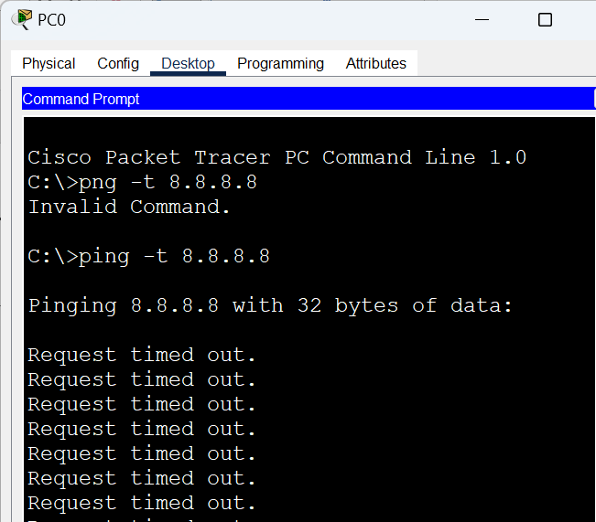
Try ping on PC0 and PC1 – Should not work
ping –t 8.8.8.8 on both the PCs … Sample screen for PC0

Slide 38
Create and Apply ACL on asa
ciscoasa(config)#access-list myacl extended permit tcp any any
ciscoasa(config)#access-list myacl extended permit icmp any any
ciscoasa(config)#access-group myacl in interface outside

Slide 39
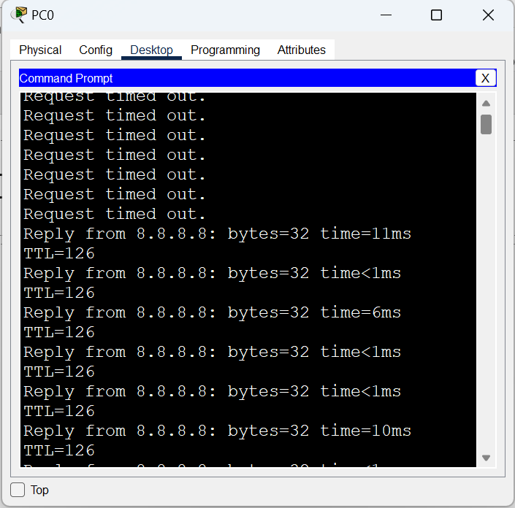
Check the ping Screen Again

Slide 40
iptables

Slide 41
iptables
The firewall solution in Linux is netfilter (https://www.netfilter.org/).
It is a packet filter inside Linux kernel.
Enables
Packet filtering
NAT/PAT (Port)
Packet logging
etc
The netfilter project is controlled by iptables and its successor nftables.
iptables is a generic firewall software that allows you to define rulesets. Each rule within an IP table consists of a number of classifiers (iptables matches) and one connected action (iptables target).
nftables is the successor of iptables, it allows for much more flexible, scalable and performance packet classification. This is where all the fancy new features are developed.
Netfilter is an infrastructure; it is the basic API that the Linux 2.4 kernel offers for applications that want to view and manipulate network packets. Iptables is an interface that uses Netfilter to classify and act on packets.

Slide 42
More Technical Details
netfilter belongs to the kernel space and iptables belongs to the user space
Only root user can configure the netfilter framework

Slide 43
Chain Traversal
Incoming traffic is filtered on the input chain of the filter table
Outgoing traffic is filtered on the output chain of the filter table
Routed traffic is filtered on the forward chain of the filter table
SNAT/Masquerade is filtered on the postrouting chain of the nat table
DNAT/Port forwarding is filtered on the prerouting chain of the nat table
To modify values from the packet’s headers, add rules to the mangle table
To skip the connection tracking, add rules with NOTRACK target to the raw table

Slide 44
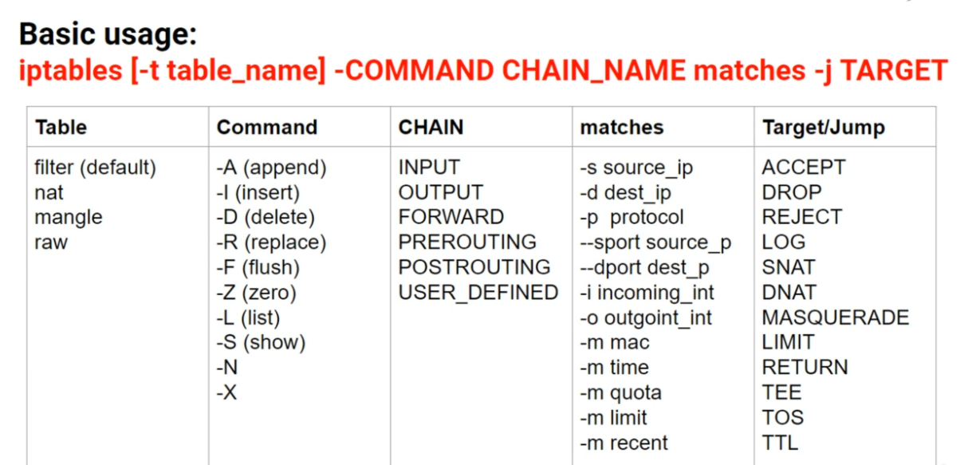
iptables Command

Slide 45
iptables Hands-on

Slide 46
Requirements
Oracle VirtualBox
Install Some linux (e.g. Kali Linux)
Install a second VM (e.g. Metasploit machine)

Slide 47
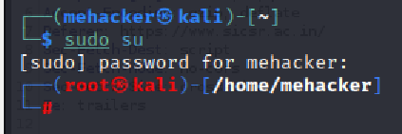
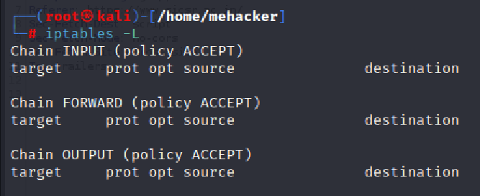
Kali Linux - Login as su
On the Kali Linux VM, sudo su and password for your user id
iptables -L

Slide 48
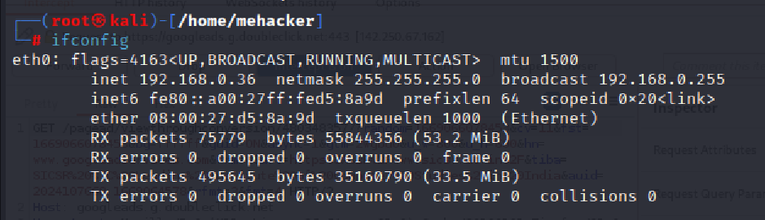
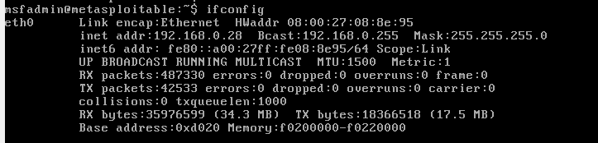
Check IP Addresses of Both
Kali Linux: ifconfig
Metasploit: ifconfig

Slide 49
Exercise 1: Try Adding a Rule Using iptables
Kali Linux IP address was 192.168.0.36
Metasploit IP address was 192.168.0.28
Ping Kali from Metasploit – Make sure it works
Then add iptables rule to Kali to drop the packet
Metasploit ping to Kali should stop

Slide 50
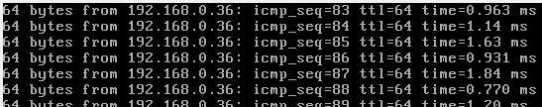
On Metasploit: ping 192.168.0.36
On Kali: iptables -t filter -A INPUT -p icmp --icmp-type echo-request -j DROP

Slide 51
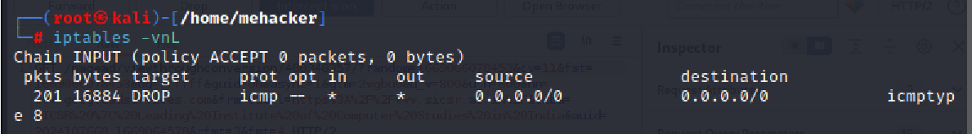
Result
L = List rules
v = Display detailed information
n = Display IP addresses and port numbers in numeric format
Check Metasploit: ping should have stopped
On Kali: iptables -vnL

Slide 52
Exercise 2: Do not Allow Kali Machine to Access www.ubuntu.com
How to construct this command:
We are going to filter traffic, so we are using the filter table
iptables -t filter
We are going to append a new rule
iptables -t filter -A
We want to match the outgoing traffic, which means the output chain
iptables -t filter –A OUTPUT
We want to match the outgoing traffic, which means the output chain
iptables -t filter –A OUTPUT
Matching conditions: protocol = TCP, destination port = 80, URL: www.ubuntu.com
iptables -t filter -A OUTPUT -p tcp --dport 80 -d www.ubuntu.com
Execute (j)ump to the following result: drop the packet
iptables -t filter -A OUTPUT -p tcp --dport 80 -d www.ubuntu.com -j DROP

Slide 53
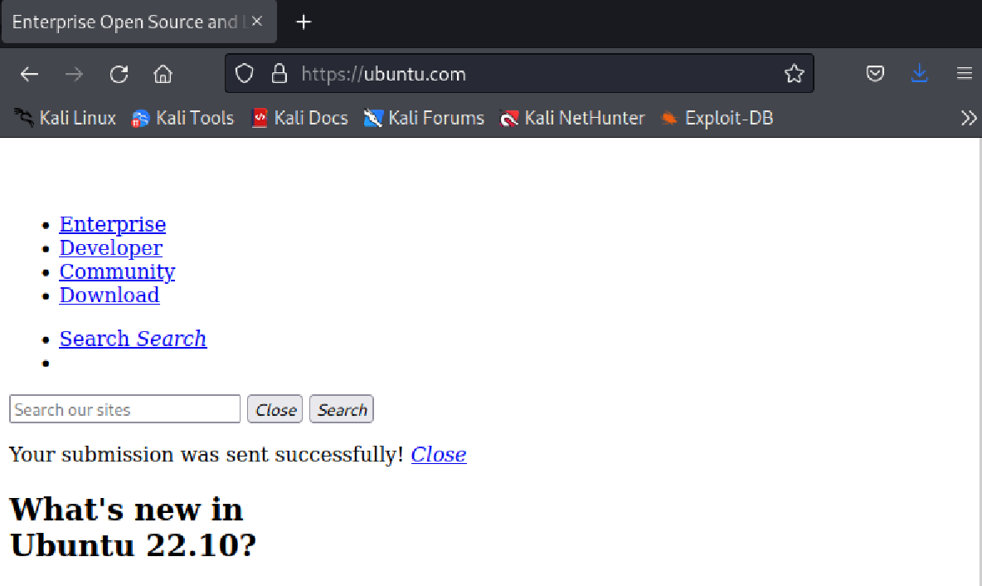
Let us first check if the page is accessible

Slide 54
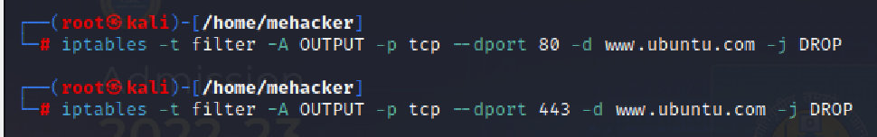
Now Add iptables Rule for Port 80 and 443 Also
iptables -t filter -A OUTPUT -p tcp --dport 80 -d www.ubuntu.com -j DROP
iptables -t filter -A OUTPUT -p tcp --dport 443 -d www.ubuntu.com -j DROP

Slide 55
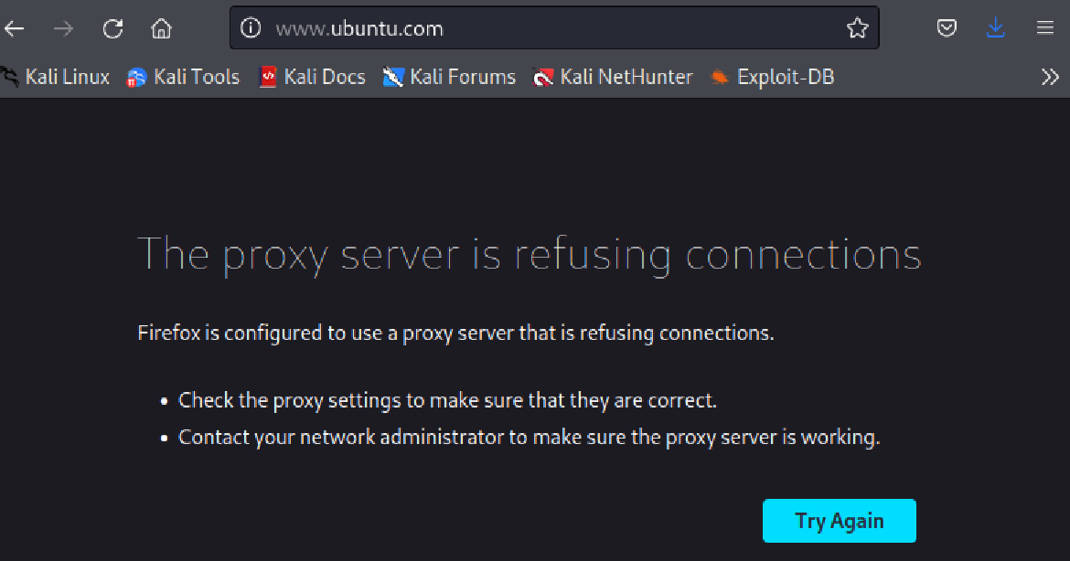
Now Try Accessing www.ubuntu.com Again
Specifically try www.ubuntu.com (As mentioned in our filtering rule)

Slide 56
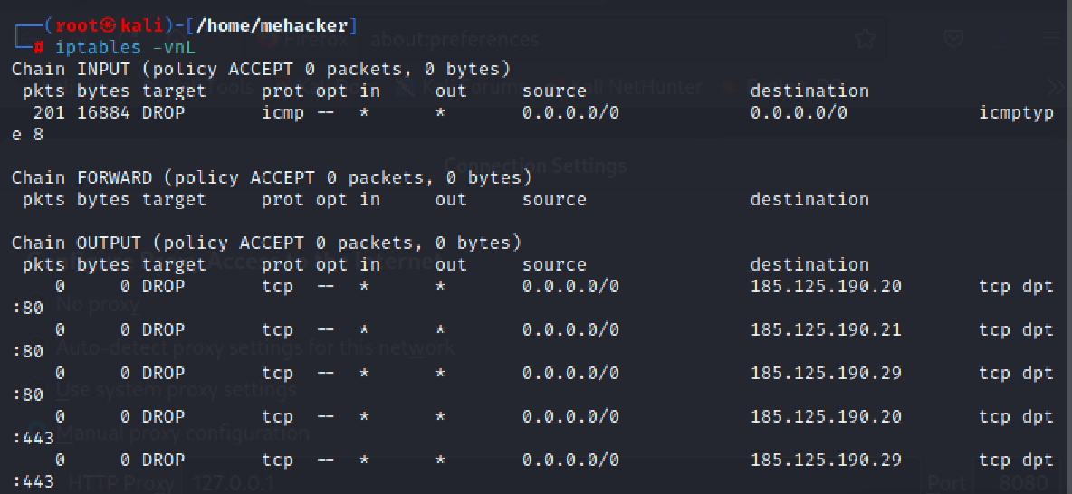
Verify
iptables -vnL

Slide 57
Prevent an External/Remote Host from Pretending to be Local to your Network
Logically:
iptables -A INPUT -i external_interface -s your_IP_address -j REJECT
Example (Assuming our network address is 192.168.18.0 and 10.0.0.0)
iptables -A INPUT -i eth1 -s 192.168.18.0/24 -j DROP
iptables -A INPUT -i eth1 -s 10.0.0.0/8 -j DROP
DROP versus REJECT
DROP just drops a packet sends a response
REJECT drops a packet and also sends a response to the sender – this can be risky for us

Slide 58
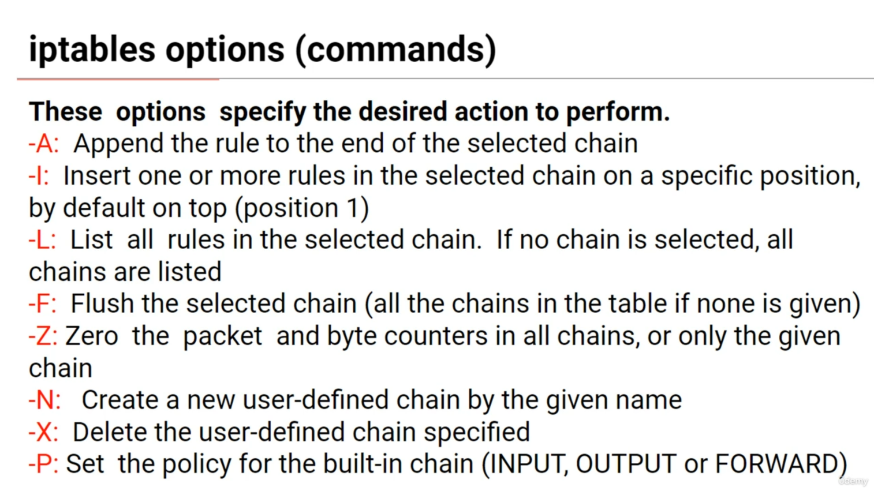
Understanding iptables Options in Detail

Slide 59
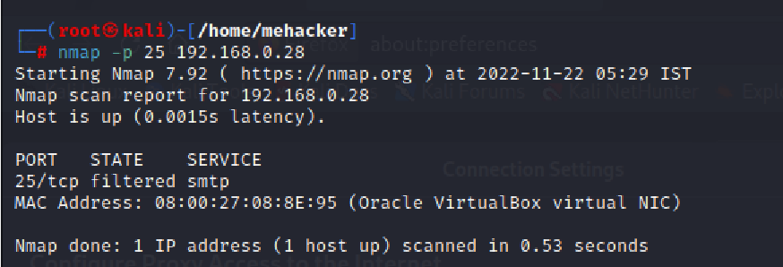
-A Example
iptables -A INPUT -p tcp --dport 25 -j DROP
On Metasploit:
sudo su
iptables -A INPUT -p tcp --dport 25 -j DROP
Then try scanning port 25 of Metasploit from Kali
nmap -p 25 192.168.0.28
If nmap is not installed, sudo apt-get install nmap

Slide 60
Deleting an iptables Rule
First see which rules are implemented: sudo iptables -L on Metsploit
Only for INPUT: sudo iptables –L INPUT
Delete a rule: sudo iptables -D [CHAIN] [LINE_NUMBER]
sudo iptables –D INPUT 1
Verify that it got deleted: sudo iptables –L INPUT
Delete all the rules for input chain: sudo iptables -F INPUT

Slide 61
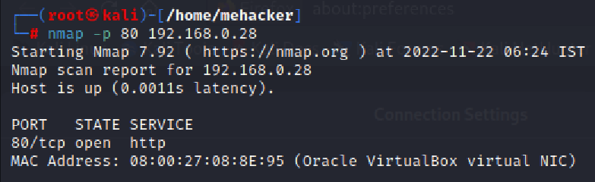
Let us Test for Web Traffic
First install Apache web server on Metasploit: apt install apache2 and if it does not work, apt-get install apache2
Let us scan port 80 of Metasploit from Kali – Success
On Kali: nmap -p 80 192.168.0.28

Slide 62
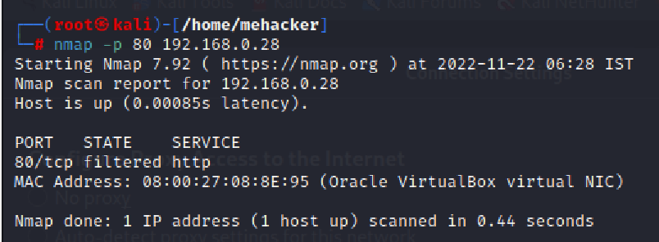
Let us Test for Web Traffic
Now let us run this command on Metasploit:
iptables -A INPUT -p tcp --dport 80 -j DROP
Let us again scan port 80 of Metasploit from Kali
On Kali: nmap -p 80 192.168.0.28

Slide 63
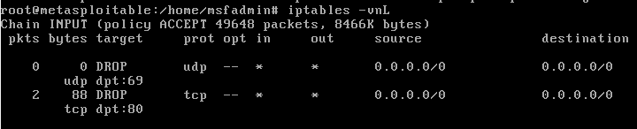
The -I Option
-A appends the rule to the end of the specified chain
But -I adds it at a specific place in the chain, as per the user-defined value iptables -I INPUT 2 -p tcp --dport 21 -j DROP and then iptables -vnL
If no value is specified, it is added at the top of the chain
Let us add a rule on Metasploit: iptables -I INPUT -p udp --dport 69 -j DROP and then iptables -vnL

Slide 64
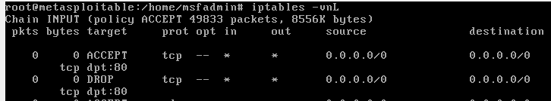
How are Rules Processed?
Top to bottom, in sequence
Hence, it is important to specify the rules precisely where we want them
Add these rules to Metasploit:
iptables -I INPUT -p tcp --dport 80 -j DROP
iptables -I INPUT -p tcp --dport 80 -j ACCEPT
Will the traffic to port 80 be accepted or dropped?
From Kali Linux, try this: 192.168.0.28 in the browser

Slide 65
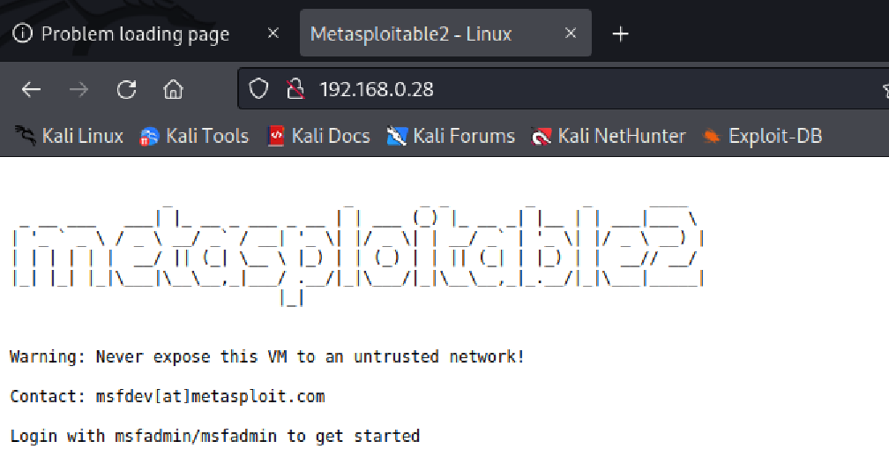
How are Rules Processed?
This is what we get on Kali Linux
Conclusion: ACCEPT got processed, DROP never got processed

Slide 66
Remove the Rules and Add in the Reverse Order on Metasploit
sudo iptables -F INPUT
iptables -I INPUT -p tcp --dport 80 -j ACCEPT
iptables -I INPUT -p tcp --dport 80 -j DROP
iptables –vnL
Try refreshing in Kali Linux … It will not show the Metasploit home page

Slide 67
Where to Write Rules?
Rules written on terminals are executed immediately, but when the computer restarts, they are removed
In such cases, we can add the rules in a shell script, make it executable, and set it to execute at boot time
Example: On the Metasploit machine
cd /
mkdir scripts
cd scripts
nano iptables_example.sh

Slide 68
iptables_example.sh
#!/bin/bash
# drop incoming ssh traffic
iptables -A INPUT -p tcp --dport 22 -j DROP
# drop outgoing http and https traffic
iptables -A OUTPUT -p tcp --dport 80 -j DROP
iptables -A OUTPUT -p tcp --dport 443 -j DROP

Slide 69
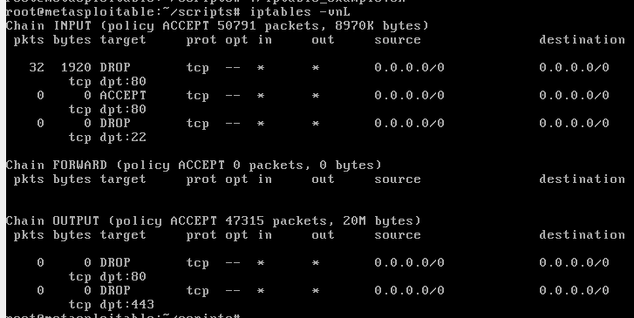
Run it
chmod 700 iptables_example.sh
./iptables_example.sh
iptables -vnL

Slide 70
Default Policy
Policy specifies what happens to the packets when they are not matched against any rule
By default, policy is set to accept all traffic
Policy can be changed only for INPUT, OUTPUT, and FORWARD chains
To change policy, we use the -P option

Slide 71
Default Policy
Default policy can be seen by using the iptables -vnL command

Slide 72
Changing the Policy
First reset the input and policy on Metasploit
sudo iptables -F INPUT
sudo iptables -F INPUT
Verify the status
iptables -vnL

Slide 73
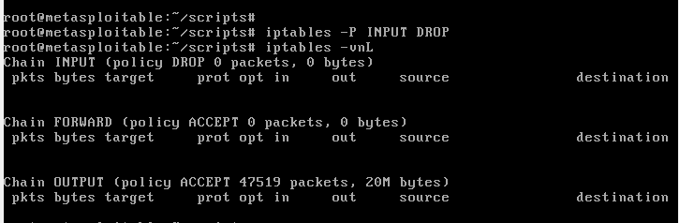
Changing the Policy
Check whether we can ping Metasploit
From Kali Linux machine
ping 192.168.0.28
If ping is successful
On the Metasploit machine: iptables -P INPUT DROP and iptables -vnL

Slide 74
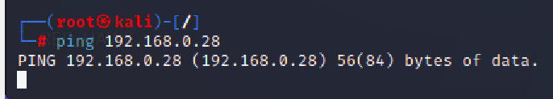
Retry Ping
Check whether we can ping Metasploit
From Kali Linux machine
ping 192.168.0.28
Should not succeed – as expected, it is stuck now
Reverse the policy on Metasploit and recheck – the Kali Linux ping should start progressing

Slide 75
Setting the Firewall to the Default State of Linux
At the very beginning of the set up, we need to be sure that we start with a very clean slate. This script may be useful for this:
#!/bin/bash
# 1. Set the ACCEPT policy
iptables -P INPUT ACCEPT
iptables -P OUTPUT ACCEPT
iptables -P FORWARD ACCEPT
# 2. Flush all the tables
iptables -t filter -F
iptables -t nat -F
iptables -t mangle -F
iptables -t raw -F
#3. Delete user-defined chains
iptables -X

Slide 76
Blocking All Traffic
iptables -F
iptables -A INPUT -j REJECT
iptables -A OUTPUT -j REJECT
iptables -A FORWARD -j REJECT

Slide 77
Filtering by IP or Network Address
1. Match by Source IP or Network Address
Match: -s IP, --source IP
Example: iptables -A INPUT -s 100.0.0.0/16 -j DROP
2. Match by Destination IP or Destination Address
Match: -d IP, --destination IP
Example: iptables -A OUTPUT -d www.ubuntu.com -j DROP

Slide 78
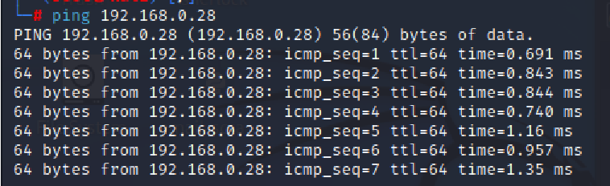
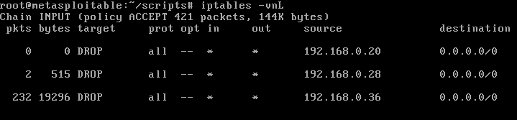
Example: Filter by Source IP Address
Check Kali Linux IP address (ifconfig) – suppose it is 192.168.0.36
From Kali Linux, ping Metasploit machine
Ping should be successful
On Metasploit, add the filtering rule:
iptables -A INPUT -s 192.168.0.36 -j DROP
Now ping should stop (verify on Metasploit: iptables -vnL)

Slide 79
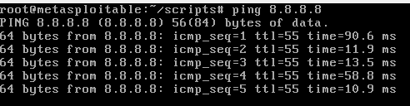
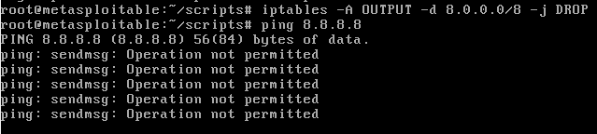
Example: Filter by Destination IP Nework Address
From Metasploit, let us first ping an IP address 8.8.8.8 – Should be successful
Stop the ping and add a rule: iptables -A OUTPUT -d 8.0.0.0/8 -j DROP try ping 8.8.8.8 again

Slide 80
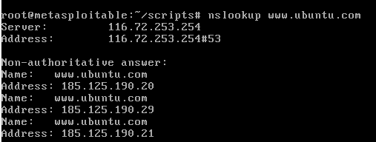
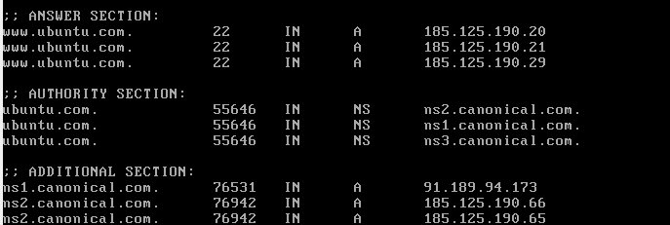
Example: Filter by Domain Name
Suppose we want to ban traffic going to www.ubuntu.com
We can of course use its IP address and filter traffic as shown in the earlier examples
To find a website’s IP address, we can use nslookup or dig command

Slide 81
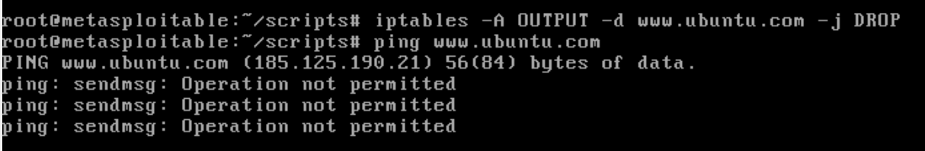
Example: Filter by Domain Name
As we can see, there are many IP addresses for www.ubuntu.com
Hence, we would need to write many filtering rules
Easier option: filter on the basis of domain name
iptables -A OUTPUT -d www.ubuntu.com -j DROP
It will automatically do it for all the IP addresses belonging to this site
(Also verify using iptables -vnL)

Slide 82
Example: Filter by Domain Name
Repeat this on Kali Linux and also check if we can open www.ubuntu.com in the browser
Another point: Do not use this technique for sites such as google.com or facebook.com, which are likely to have dozens or even hundreds of IP addresses
The DNS server will return only a few of them, and only they will be filtered
In such a case, we should use an application gateway

Slide 83
Blocking Incoming Service Requests
This can be used to block connections to a particular service, e.g. HTTP
To block all incoming HTTP traffic:
iptables -A INPUT -p tcp --dport www -j REJECT
To block all incoming HTTP traffic but to allow local HTTP traffic:
iptables -A INPUT -p tcp -i lo --dport www -j ACCEPT
iptables -A INPUT -p tcp --dport www -j REJECT

Slide 84
Blocking Outgoing Access to All Web Servers on a Network
iptables -A OUTPUT -p tcp -d 64.58.76.0/24 --dport www -j REJECT
Address is CIDR, so /24 is fine

Slide 85
Controlling Access based on MAC Addresses
Only allow a machine with a specific MAC address to access the network
iptables -F INPUT
iptables -A INPUT -i lo -j ACCEPT
iptables -A INPUT -m mac --mac-source 12:34:56:89:90:ab -j ACCEPT
iptables -A INPUT -j REJECT

Slide 86
Stateful Packet Inspection (SPI) Firewall
Connection tracking = Stateful firewall
Connection tracking: Ability to maintain state information about connections
Stateful firewalls are more secure than stateless firewalls
Stateful firewalls decide to accept or drop packets based on the relationship of these packets with other packets
Netfilter is a stateful firewall

Slide 87
Packet States
Connection tracking = Stateful firewall
Packet states
Connection tracking: The first packet in a connection
Established: Packets that are part of an existing connection
Related: Packets that are a part of an existing connection and are requesting a new connection (e.g. FTP)
Invalid: Packets that are not a part of an existing connection
Untracked: Packets marked with an NOTRACK target
Connection tracking can be used even if the protocol is stateless, such as UDP or ICMP

Slide 88
Connection Tracking
-m state --state, where state is a comma-separated list of packet states written in uppercase letters
Example: Accept packets if they are already a part of an incoming connection
Iptables -A INPUT -m state --state ESTABLISHED,RELATED -j ACCEPT

Slide 89
How to Handle State?
iptables -F INPUT
iptables -A INPUT -m state --state ESTABLISHED -j ACCEPT
iptables -A INPUT -j REJECT
Statefulness concept is used here: Permit incoming packets only if they are part of established outgoing connections. All other incoming packets are rejected.

Slide 90
Statefulness Example (stateful_script.sh)
Create the following script on Metasploi#!/bin/bash
# Flush all the tables
iptables -F
# Allow local traffic
iptables -A INPUT -i lo -j ACCEPT
iptables -A OUTPUT -o lo -j ACCEPT
# Drop traffic that is not related/stateful
iptables -A INPUT -m state --state INVALID -j DROP
iptables -A OUTPUT -m state --state INVALID -j DROP
# Allow traffic only in the related/stateful
iptables -A INPUT -m state --state ESTABLISHED,RELATED -j ACCEPT
iptables -A OUTPUT -m state --state NEW,ESTABLISHED,RELATED -j ACCEPT
# Drop everything else
iptables -P INPUT DROP
iptables -P OUTPUT DROP

Slide 91
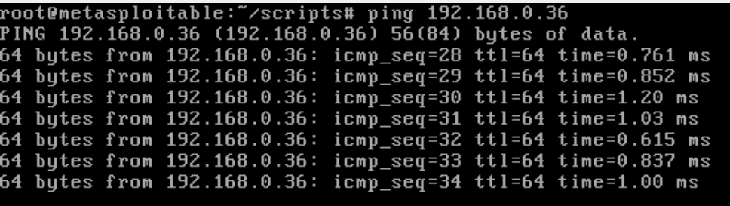
Testing
Save and execute this script on Metasploit
Try pinging Kali Linux from Metasploit – Success

Slide 92
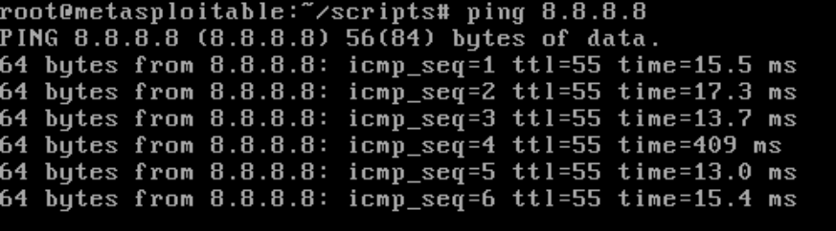
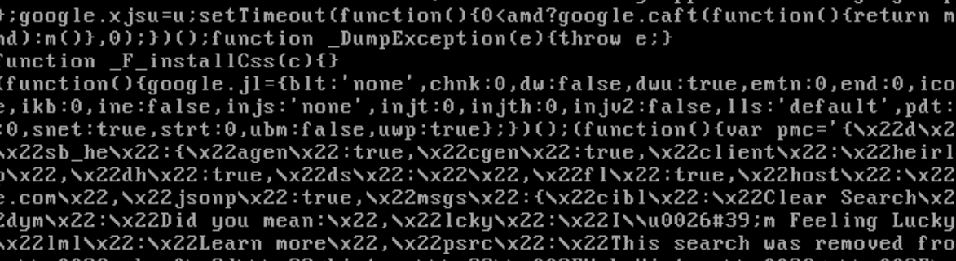
Testing
Try pinging 8.8.8.8 from Metasploit – Success
Try accessing HTTP: curl www.google.com - Success

Slide 93
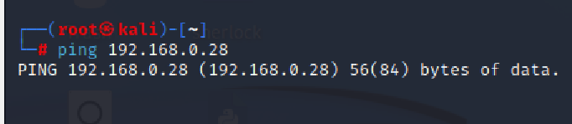
Testing
Now try pinging Metasploit from Kali – Will not work

Slide 94
Log Packets
On target machine (IP 192.168.0.35)
iptables -A INPUT -s 192.168.0.31/24 -j LOG --log-level 4
On source machine (IP 192.168.0.31)
ping 192.168.0.35
We have told the target machine to log all requests coming from the source machine
To verify, on the target machine: tail -f /var/log/kern.log

Slide 95
Creating a Custom Chain to Log and Drop
Create a new custom list of rules
Specify that we want logging at level 6 (most detailed)
Add a rule that says what should be the action if our custom chain is activated
Apply the custom chain as a target to a specific rule
On the first/source machine (192.168.0.31)
ping 192.168.0.35
On the second/target machine (192.168.0.35)
iptables -N LOG_DROP
iptables -A LOG_DROP -j LOG --log-level 6
iptables -A LOG_DROP -j DROP
iptables -A INPUT -p icmp --icmp-type echo-request -j LOG_DROP
Now ping should stop
On the second machine, tail -f /var/log/kern.log (See next slide)
Normal statement for INPUT chain: iptables -A INPUT -p icmp --icmp-type echo-request -j DROP, but for our custom chain: iptables -A INPUT -p icmp --icmp-type echo-request -j LOG_DROP

Slide 96
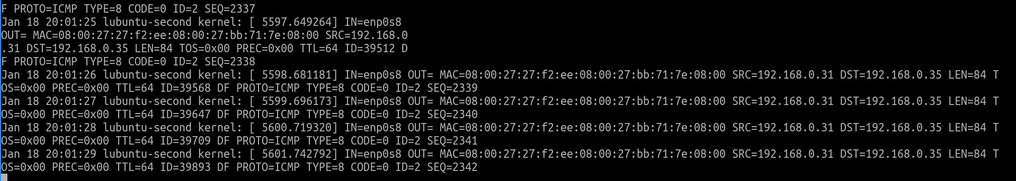
Log output

Slide 97
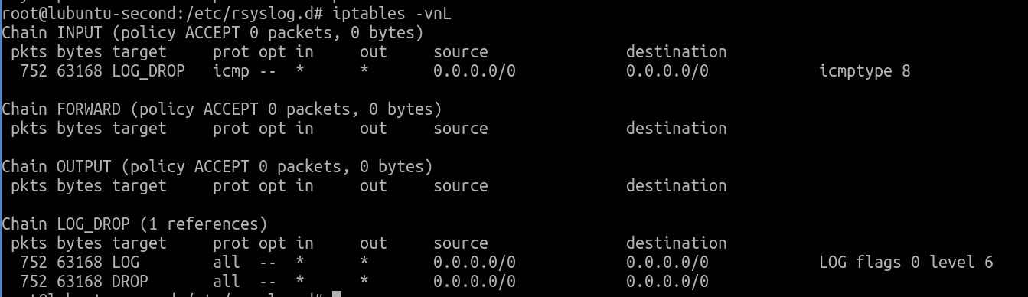
What does iptables -vnL Show?
Our custom chain is working on the INPUT chain, as expected

Slide 98
Flushing
Remember, we now need iptables -F and iptables -X
The first command will flush all rules, but will keep an entry of our custom chain (empty)
The second command will remove this empty custom chain also

